Slide 1
DEPARTMENT OF COMPUTER SCIENCE & ENGINEERING
SCHOOL OF COMPUTING
1156CS601- MINOR PROJECT
WINTER SEMESTER(20-21) INITIAL REVIEW
“LICENCE PLATE RECOGNITION SYSTEM USING OpenCV”
SUPERVISED BY
PRESENTED BY
Dr. R. Aruna
Vtu 11454 - AYUSHI (18UECS0100)
Vtu 13531 - ANKIT DIXIT (18UECS0066)
Vtu 11313 - BISHAL SAHA (18UECD0005)

Slide 2
AGENDA
ABSTRACT
OBJECTIVE
INTRODUCTION
LITERATURE REVIEW
DESIGN AND METHODOLOGIES
IMPLEMENTATION
CODE IMPLEMENTATION
TESTING
INPUT AND OUTPUT
CONCLUSION
RESULT AND ANALYSIS
REFERENCES
9.03.2021

Slide 3
ABSTRACT
Licence plate recognition is a technique of image processing which finds it’s usage in many aspect of day-to-day life for instance; maintenance of traffic in busy roads, vehicle security, surveillance.
As the name suggests,Licence plate recognition is a technique to automatically detect the licence number plate without any human interference. The detection consists of three main steps: motion detection, license plate detection, and license plate tracking.
This is also highly useful when it comes to detecting stolen vehicles.ALPR is gaining popularity in security and traffic installations. The technology concept assumes that all vehicles already have the identity displayed (the plate!) so no additional transmitter or responder is required to be installed on the car.
09.03.2021

Slide 4

OBJECTIVES
Aim of the project :
A (LPR) License Plate Recognition system aims to recognize license plate using openCV.
This technology.could be used in various application, such as security and traffic control system features.
This image processing technique will be used to scan and recognize the character on the license plate by using various techniques like binarizing, segmenting, etc of image.
Scope of the project :
License Plate Detection can also help us identify violators of the traffic rules, especially at signals, etc. Automatic License Plate Detection in case of two wheelers, can be combined with helmet detection for possible drivers not wearing helmets while driving.

Slide 5
INTRODUCTION
License plate detection also has various application such as parking lot management, stolen vehicle identification, traffic flow monitoring, electronic toll collection, etc.
This particular topic has.been extensively researched by researchers worldwide to improve the performance.
It uses the concept of optical character recognition (OCR) on the license plate image to recognize and extract the characters of a vehicle number plate.
The OpenCV library is used using Python language for image processing.
PyTesseract is used for optical character recognition for text extraction from processed license image.
09.03.2021

Slide 6
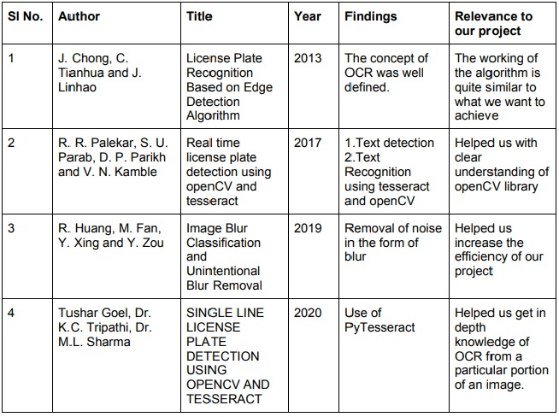
LITERATURE REVIEW
09.03.2021

Slide 7
DESIGN AND METHODOLOGIES
License plate of the vehicle is detected using various features of image processing library openCV and recognizing the text on the license plate using python tool named as tesseract.
To recognize the license plate we are using the fact that License plate of any vehicle has rectangular shape.
So, after all the processing of an image we will find the contour having four points inside the list stand consider it as the License Plate of the vehicle
we will then sort the contours to avoid small and useless contour made by noise and rather focus on larger ones which contains number in it.
we will then use cv2.approxPolyDP() to count the number of sides and it’s rectangular shape using the function cv2.boundingRect(c).
After detection of licence plate, we will now use the concept of OCR(Optical Character Recognition) using python-Tesseract to extract numbers and alphabets from the licence plate.
09.03.2021

Slide 8
IMPLEMENTATION
ARCHITECTURE DIAGRAM
Level 1
Level 2
Level 3
Level 4
IMPORT LIBRARIES AND IMAGE
PREPROCESSING
LOCALIZATION OF PLATE
TEXT RECOGNITION
09.03.2021

Slide 9
Data Flow diagram
01
Fetch Image
OpenCV
02
Pre-processing
RGB to gray
Bilateral filter
03
Plate Localization
Canny edge detection
Area, perimeter, shape
Finding contour
04
Character Recognition
Using pytesseract

Slide 10
Class Diagram
Plate Localization
Attributes edged image1 image2 approx
Operation canny() findContours() cv2.approxPolyDP()
Fetch Image
Attributes Image file name
Operation cv2.imread() cv2.imshow()
Pre-processing
Attributes Gray Image
Operation cv2.cvtcolor() imutils.resize() cv2.bilateralFilter()
Character recognition
Attributes Text
pytesseract.image_to_string()

Slide 11
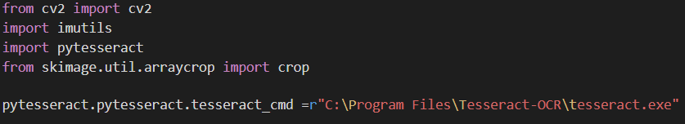
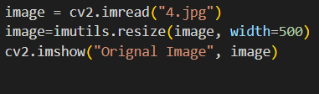
Code Implementation
In order to implement the code we need to install some libraries. So, that we can import the and use it in our project.
openCV
imutils
pytesseract OCR
First, we will specify the location of pytesseract to use it.
Now, we will fetch the image. Also, we will resize and standardize the image using imutils and display the original image.

Slide 12
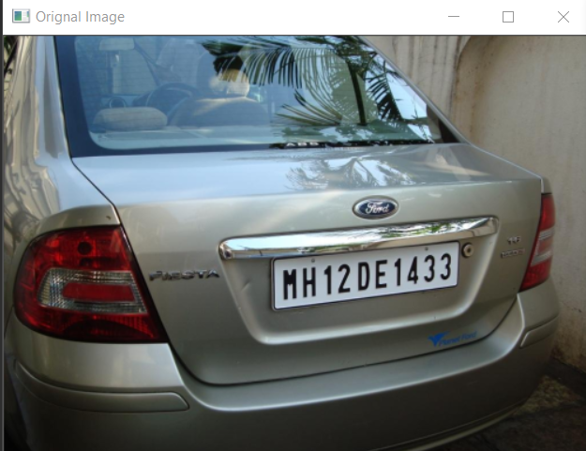
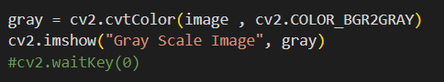
Now, we will convert our image to grayscale which will reduce the dimension and also the complexity of the image. Also there are some algorithm like canny that work only with gray scale image.

Slide 13
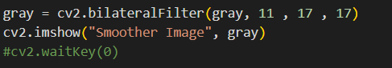
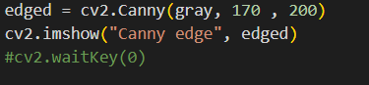
Now, we will reduce noise from the image and make it smooth(bilateralfilter).
Now we will find the edge of the image using canny edge detection algorithm in order of extraction of the image.
Now we will find the contours based on the image.
Here, cntns is contours which means that it is like the curve joining all the contour points. new is hierarchy relationship, RETR_LIST - it retrieves all the contours but does not create any parent child relationship, CHAIN_APPROX_SIMPLE - it removes all the redundant points and compress by saving memory.

Slide 14
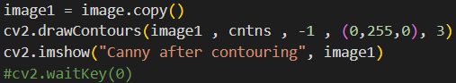
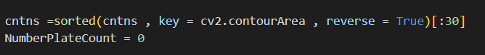
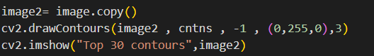
Now we will copy all the image to draw all the contours.
Now we don't want all the contours we are interested only in number plate.But we can't directly locate that so we will sort them on the basis of their areas and will select those area which are maximum. So, we will select top 30 areas but it will give sorted list as in order of min to maximum. So for that we will reverse the order of sorting.
Because currently we don’t have any contours or it will show how many number plates are there in the image. To draw top 30 contour we will make a copy of original image and use. Because we dont want to edit anything in our original image.

Slide 15
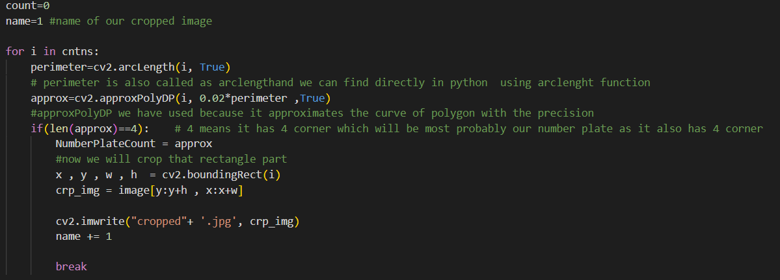
Now, we will run a loop on our contour to find the best possible contour of our number plate.

Slide 16
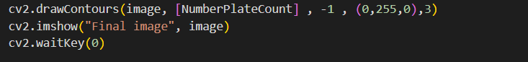
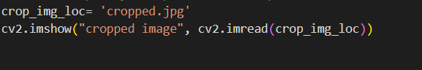
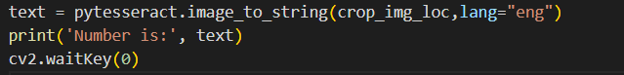
Now, we will apply these contour generated on the extracted image
Now, we will crop the part where our number plate is based on the contour.
Now, we will perform character recognition using pytesseract in order to recognize the character on the license plate

Slide 17
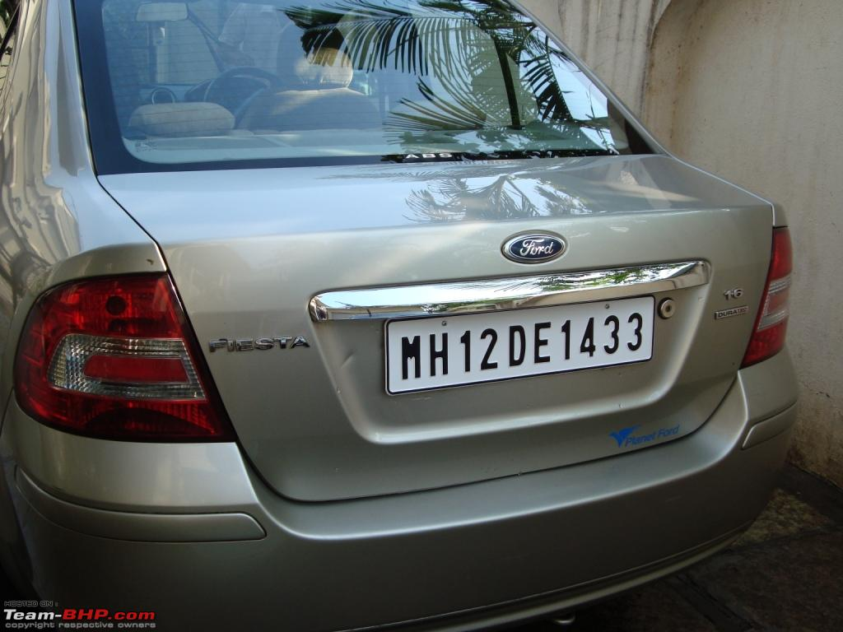
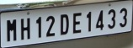
Software Testing
Unit Testing : Unit testing is the process of checking every unit of a complex program individually. In this type of testing all the modules are tested to determine if they are fit for purpose.
Test cases for plate localization
Description of Test Cases | Input | Output | Status
Back view of a car |  |  | Pass

Slide 18
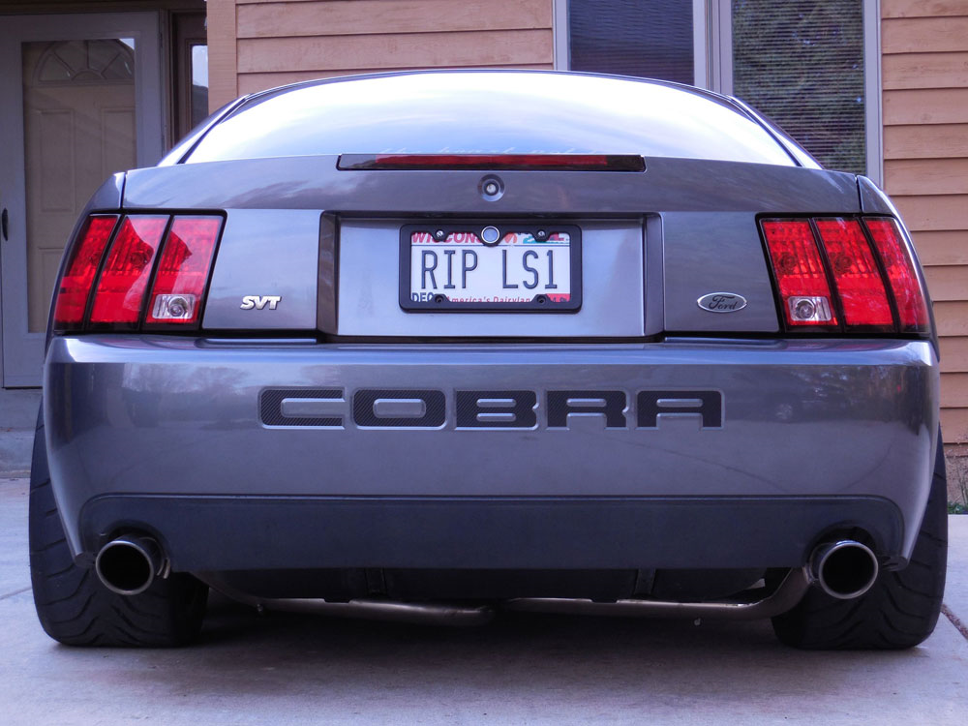

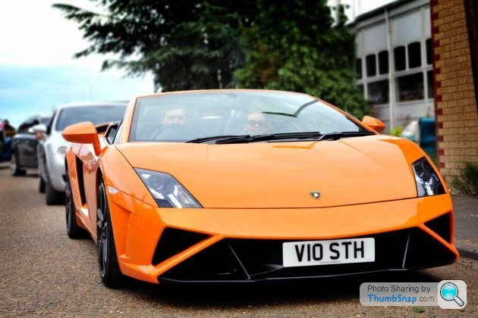
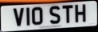
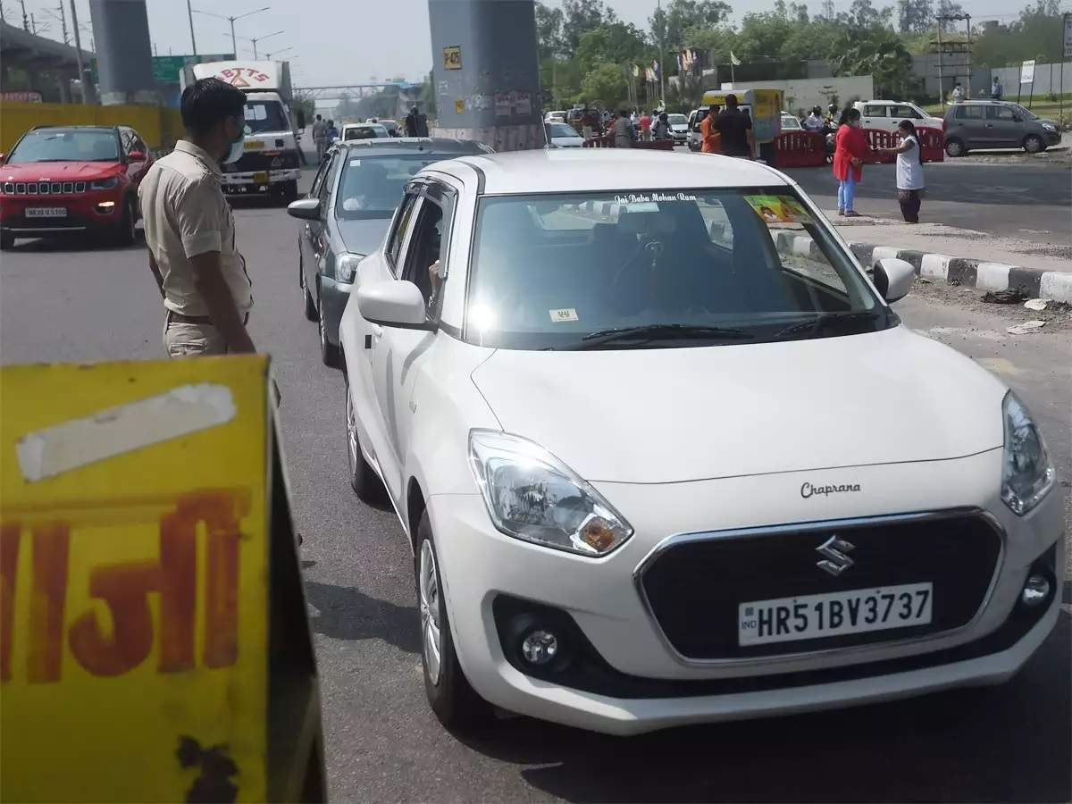
Back view of the car |  |  | Pass
Front view of the car |  |  | Pass
Front view of the car |  |  | Pass

Slide 19
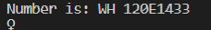
Test cases for character recognition
Description of Test Cases | Input | Expected output | Output | Status
Optical character recognition of an image |  | RIPLS1 |  | PASS
Optical character recognition of an image |  | MH12DE1433 |  | FAIL

Slide 20
Optical character recognition of an image |  | Vi0STH |  | PASS

Slide 21
System Testing:
System testing is a black box testing technique used to evaluate complete system. Black box testing is an important factor used for the testing process. It enables
us to identify and debug the errors that might creep inside while executing the
program. Our model passed this test with an ease.
Description of Test Cases | Input | Expected Output | Output | Status
Image is used as an input for recognition of characters on license plate |  | RIPLS1 |  | PASS
Image is used as an input for recognition of characters on license plate |  | MH12DE1433 |  | FAIL

Slide 22
Image is used as an input for recognition of characters on license plate |  | Vi0STH |  | PASS
Image is used as an input for recognition of characters on license plat |  | HR51B3737 |  | PASS

Slide 23
INPUT and OUTPUT
Input

Slide 24
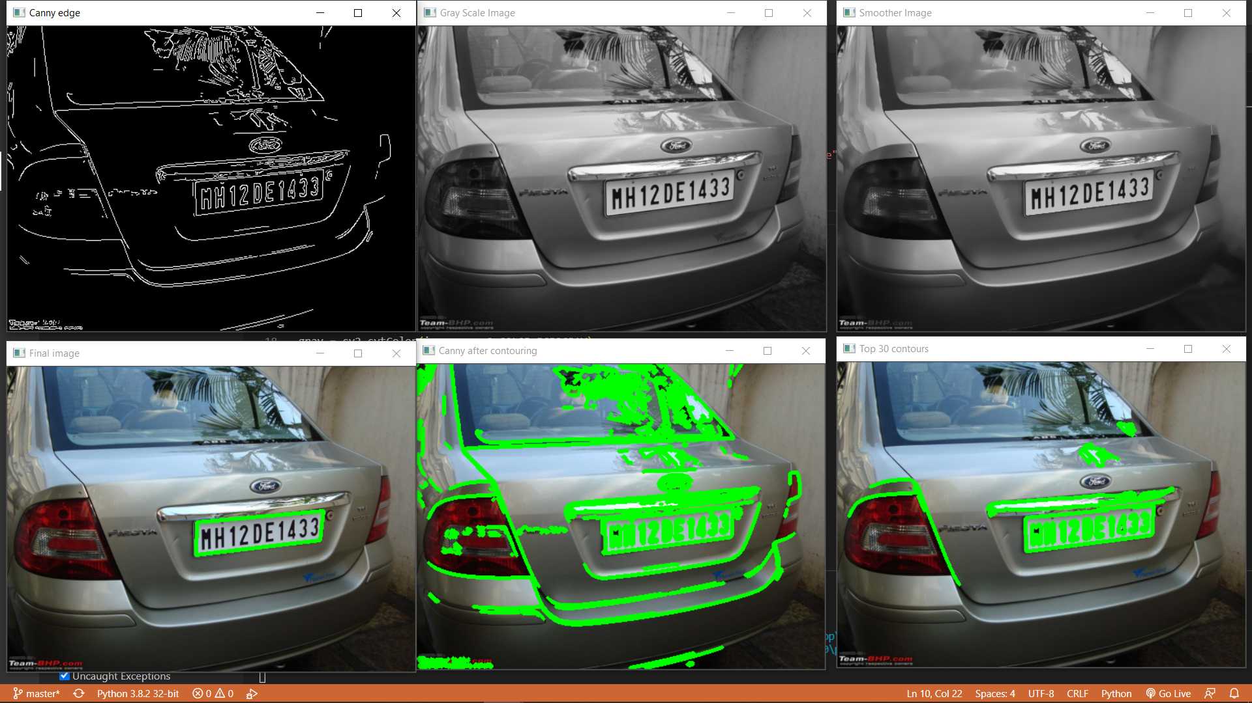
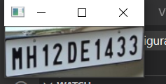
Output

Slide 25
RESULT and ANALYSIS
Out of 100 sample number plates, 88 were detected successfully giving the project a success rate of 88%
Dirty Number plate with lot of noise were a major problem faced
Edge detection stayed accurate for an angle of 30 degrees
Faded characters greatly hampered the plate segmentation process which in turn affected character recognition

Slide 26
RESULT
ACTUAL | PREDICTED | PRECISION | RECALL | ACCURACY
 | RIPLS1 | 100% | 100% | 100%
 | WH12DE1433 | 100% | 85.71% | 85.71%
 | Vi0STH | 100% | 95% | 95%
 | HR51B3737 | 100% | 100% | 100%

Slide 27
CONCLUSION
The method used is efficient, accurate and less time consuming
It promises less chances of error provided it is being implemented in suitable conditions
With proper Implementation of the same we can manage traffic and increase car security
Further improvements can always be done by using more advanced deep learning algorithms so it can work in every possible condition and can be implements in real-time monitoring, multiple license plate detection at a time, etc.
09.03.2021

Slide 28
REFERENCES
[1] J. Chong, C. Tianhua and J. Linhao, "License Plate Recognition Based on Edge Detection Algorithm," (2013)
[2]R. R. Palekar, S. U. Parab, D. P. Parikh and V. N. Kamble, "Real time license plate detection using openCV and tesseract," (2017 )
[3]R. Huang, M. Fan, Y. Xing and Y. Zou, "Image Blur Classification and Unintentional Blur Removal,"( 2019)
[4].J.R. Parker and P. Federl, An Approach To Licence Plate Recognition, (2006).
[5] S.-L. Chang; L.-S. Chen; Y.-C. Chung; S.-W. Chen, Automatic License Plate Recognition using Intelligent Transportation Systems 5 (2014)
[6] S. Draghici, A neural network based artificial vision system for licence plate recognition(2007)
09.03.2021

Slide 29
THANK YOU

